Slide 1
MSc Artificial Intelligence
Knowledge Engineering
28 September 2026
Notes:
This colour bar is to be used for Artificial Intelligence

Slide 2
Recap
Facts represented as propositions
Natural deduction: Proof of new statements
Logic Programming: automation of natural deduction

Slide 3
Propositions
  A proposition is a statement that can be True or False
    It is colder in the winter than in the summer.
    Mount Everest is the tallest mountain in the world.
    Water makes you wet.
  A Premise is a stated proposition and is like an axiom
  A Conclusion is derived purely from the premise
  Socrates is a man [Premise]
  All men are mortal [Premise]
  Therefore, Socrates is mortal [Conclusion]

Slide 4
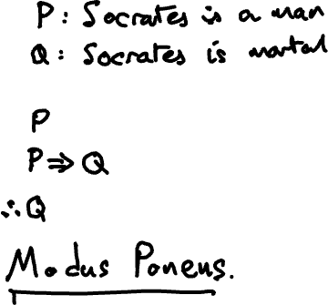
Symbolic Logic
Notes:
S: Socrates is a human S -> H
M: All humana are mortal H -> M
S
Therefore M

Slide 5


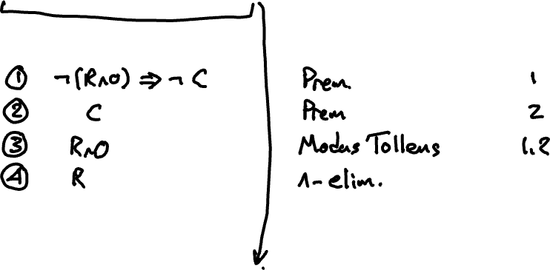
Example of a Formal Proof
Step |  | Inference Rule | Premises used

Slide 6

Logic Programming
$$P∧¬Q$$
$$Q∨R \\ ∴R$$
from kanren import var, eq, lall, lany run
P, Q, R = vars()
goals = lall(
lall(eq(P, True), eq(Q, False)),
any(Q,R)
)
run(0, R, goals)

Slide 7
This week:
Continue learning logic programming
Practice writing logic programs
How natural deduction is automated by search
First order logic, introducing variables and quantifiers

Slide 8
Logic Programming
Let’s continue where we left off last week…

Slide 9
1.09 Exercises Kanren.ipynb

Slide 10
Automating Reasoning

Slide 11
How Automated Reasoning works
Natural deduction has many rules
How we apply them and in what order is not obvious and relies on “human intuition”.
Computers don’t have human intuition…..

Slide 12
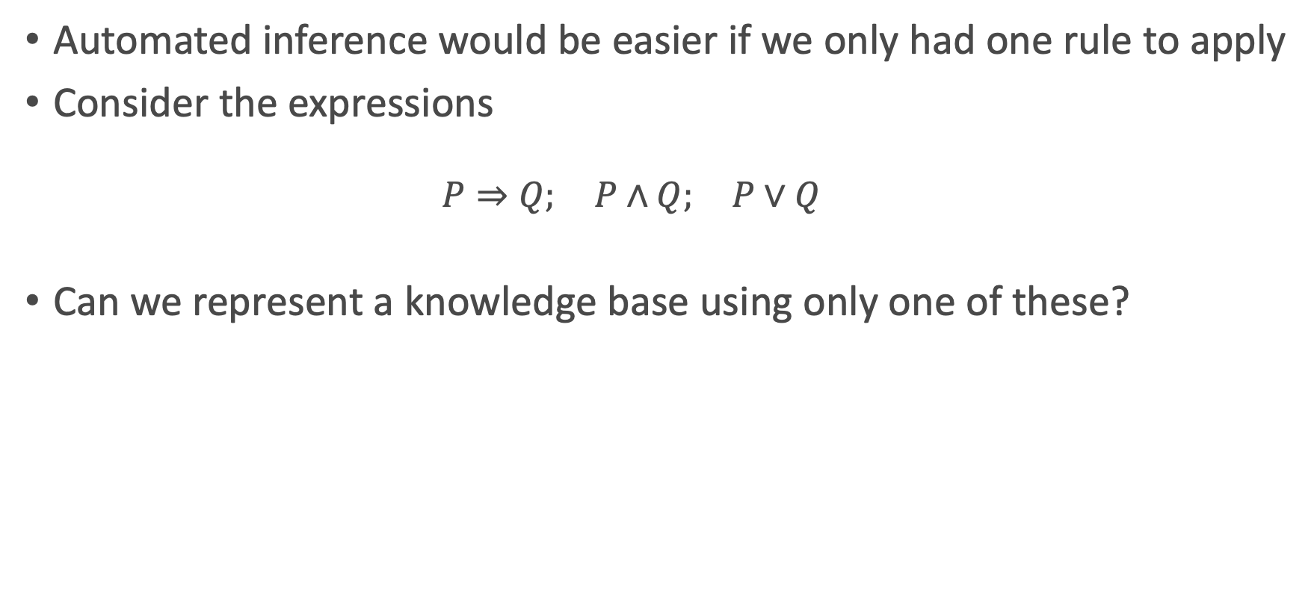
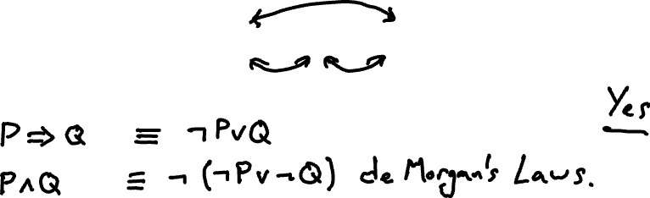
Logical Equivalencies
Automated inference would be easier if we only had one rule to apply
Consider the expressions
  $$P⇒Q; P∧Q; P∨Q$$
Can we represent a knowledge base using only one of these?
Notes:
P=>Q is !PvQ == !(P^!Q)
Therefore PvQ == !P=>Q and P^Q == !(P=>!Q)

Slide 13
Rule Based Systems
If we can represent a Knowledge base purely in terms of material implication and negation, we only need one inference rule: modus ponens
Will allow us to prove logical statements by either:
Systematically deriving new facts until we find the one we want
Systematically exploring the known facts to establish compatibility.

Slide 14
An Example
1. A ⇒ V
2. B ⇒ U
3. B ⇒ V
4. C ⇒ U
5. C ⇒ W
6. D ⇒ X
7. D ⇒ Z
8. E ⇒ W
9. E ⇒ X
10. F ⇒ Y
11. F ⇒ Z
12. U ⇒ O
13. V ⇒ O
14. W ⇒ O
15. W ⇒ I
16. X ⇒ I
17. Y ⇒ I
18. Y ⇒ O
19. Z ⇒ I
Knowledge base of medical treatments.
Includes facts about diseases and the medicines that can be used to treat them:
There are six diseases {A, B, C, D, E, F }.
There are five medicines {U, V, W, X, Y, Z}
The medicines are available in either oral or injectable form {O, I}.
KB tells us which medicines treat a disease, and what form each medicine is available in
We have the following rules:

Slide 15

Forward Chaining
1. A ⇒ V
2. B ⇒ U
3. B ⇒ V
4. C ⇒ U
5. C ⇒ W
6. D ⇒ X
7. D ⇒ Z
8. E ⇒ W
9. E ⇒ X
10. F ⇒ Y
11. F ⇒ Z
12. U ⇒ O
13. V ⇒ O
14. W ⇒ O
15. W ⇒ I
16. X ⇒ I
17. Y ⇒ I
18. Y ⇒ O
19. Z ⇒ I
In forward chaining, we start with a fact and a goal, and we explore the implications in a forward direction to find out whether our goal is satisfied.
Given disease B (fact), is there an oral medication available (goal)?

Slide 16
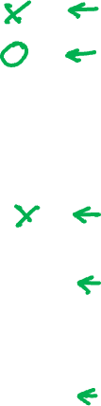
Backward Chaining
1. A ⇒ V
2. B ⇒ U
3. B ⇒ V
4. C ⇒ U
5. C ⇒ W
6. D ⇒ X
7. D ⇒ Z
8. E ⇒ W
9. E ⇒ X
10. F ⇒ Y
11. F ⇒ Z
12. U ⇒ O
13. V ⇒ O
14. W ⇒ O
15. W ⇒ I
16. X ⇒ I
17. Y ⇒ I
18. Y ⇒ O
19. Z ⇒ I
In backward chaining, we start with our goal, and work through the implications backwards to see if the goal is supported by the facts
Given that the patient wants oral medication O, is that suitable for their disease B?

Slide 17
Forward vs Backward Chaining
1. A ⇒ V
2. B ⇒ U
3. B ⇒ V
4. C ⇒ U
5. C ⇒ W
6. D ⇒ X
7. D ⇒ Z
8. E ⇒ W
9. E ⇒ X
10. F ⇒ Y
11. F ⇒ Z
12. U ⇒ O
13. V ⇒ O
14. W ⇒ O
15. W ⇒ I
16. X ⇒ I
17. Y ⇒ I
18. Y ⇒ O
19. Z ⇒ I
Forward chaining: given the facts, what goals can we solve?
Backward chaining: is the goal we want to solve supported by the evidence?

Slide 18
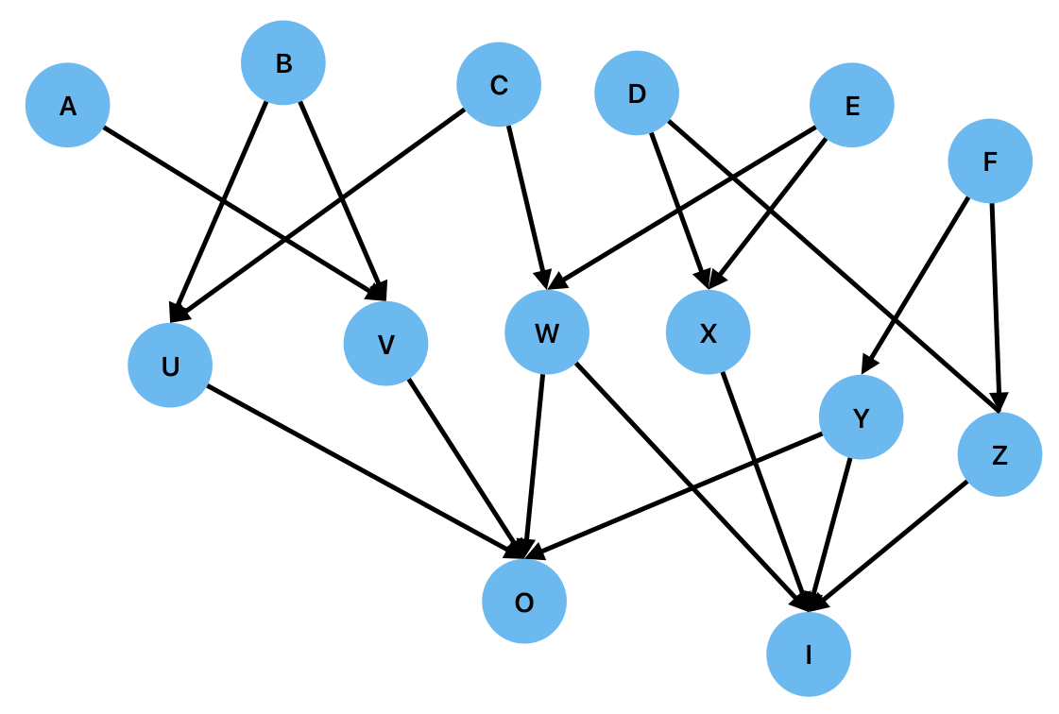
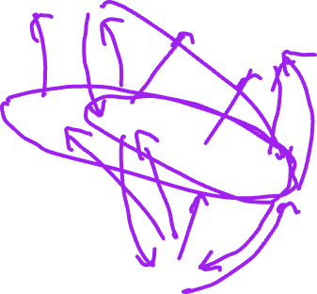
Search and Proof
1. A ⇒ V
2. B ⇒ U
3. B ⇒ V
4. C ⇒ U
5. C ⇒ W
6. D ⇒ X
7. D ⇒ Z
8. E ⇒ W
9. E ⇒ X
10. F ⇒ Y
11. F ⇒ Z
12. U ⇒ O
13. V ⇒ O
14. W ⇒ O
15. W ⇒ I
16. X ⇒ I
17. Y ⇒ I
18. Y ⇒ O
19. Z ⇒ I
What forms of drug can be used to treat disease D?
What diseases can be treated with an injection?

Slide 19
Search and Proof
Inference in rule based systems is equivalent to search on a directed graph
A proof corresponds to finding a path in the graph between the premises and the goal.
In forward chaining, we start with the premises
Patients has disease B. Can we treat it with Oral medication?
In backward chaining, we start with the goal
Oral medication. Can it treat disease B?
Both cases require us to traverse the graph. How to do this systematically?

Slide 20
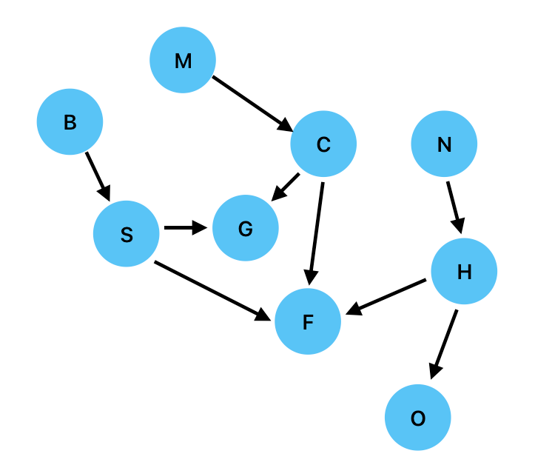
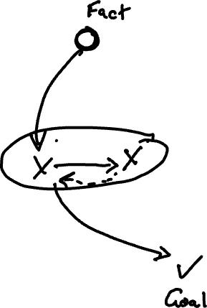
Breadth-First Search (Forward Chaining)

Slide 21
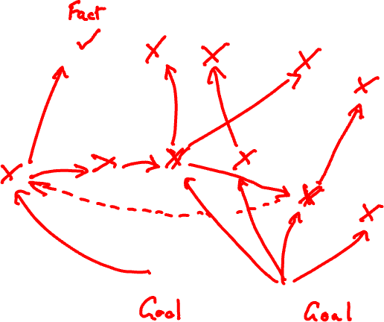
Breadth-First Search (Backward Chaining)

Slide 22
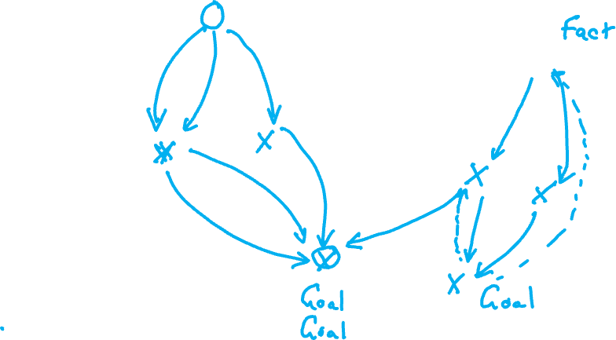
Depth-First Search (Forward Chaining)

Slide 23
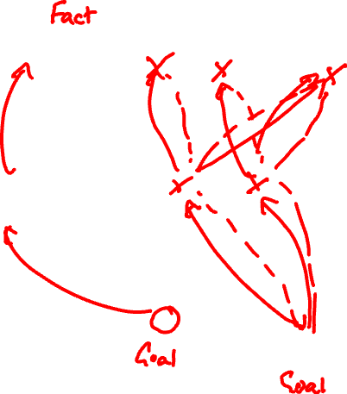
Depth-First Search (Backward Chaining)

Slide 24
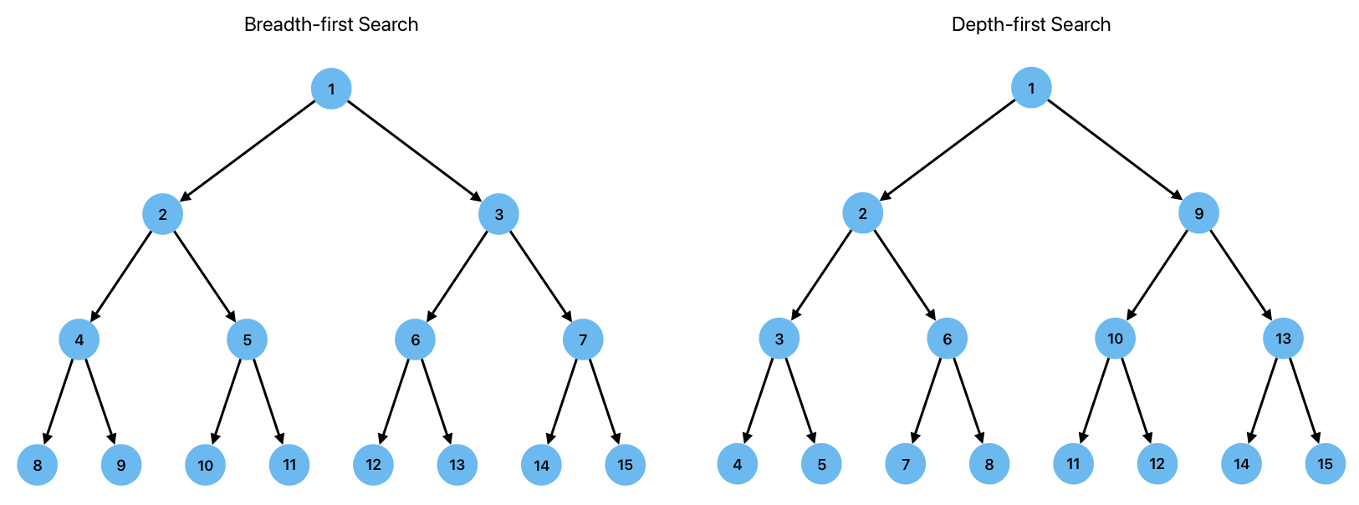
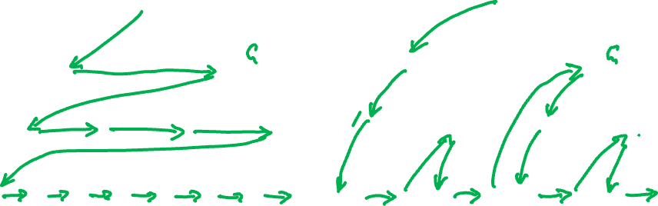
Breadth vs Depth-First Search

Slide 25
1.11 Exercises Automating Natural Deduction.ipynb

Slide 26
First Order Logic

Slide 27
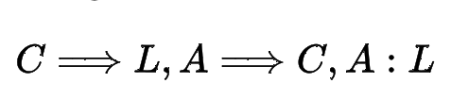
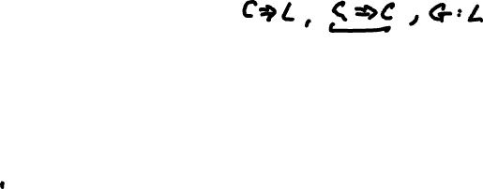
A Problem with Propositions
All computer scientists are logical
Alan is a computer scientist
Therefore Alan is logical
  We can represent this easily this in propositional logic
  What about another computer scientist, Grace?
  Our argument above is about Alan.
  We need to construct another argument for Grace.
  What about Physicists, Philophers, Classicists?
  This seems……wasteful

Slide 28
First Order Logic
Even worse….
All women are mortal
Some women have black hair
Therefore all women with black hair are mortal
Do our tools allow us to prove that this is a valid argument?
These are all propositions, but they use quantifiers (all, some)
No tools for working for this in propositional logic.
Careful definitions of the sentences has got us out of trouble so far but won’t work here.
We need some new mechanisms.

Slide 29
First Order Logic
Propositions have to be unconditionally True or False
  All men are mortal
  Socrates is a man
  It always rains in Belfast
First order logic introduces mechanisms that allow us to include and reason about
  Variables (Men, Socrates, Belfast etc)
  Quantifiers (all, some)
  Predicates (is mortal, is a man, it rains)

Slide 30
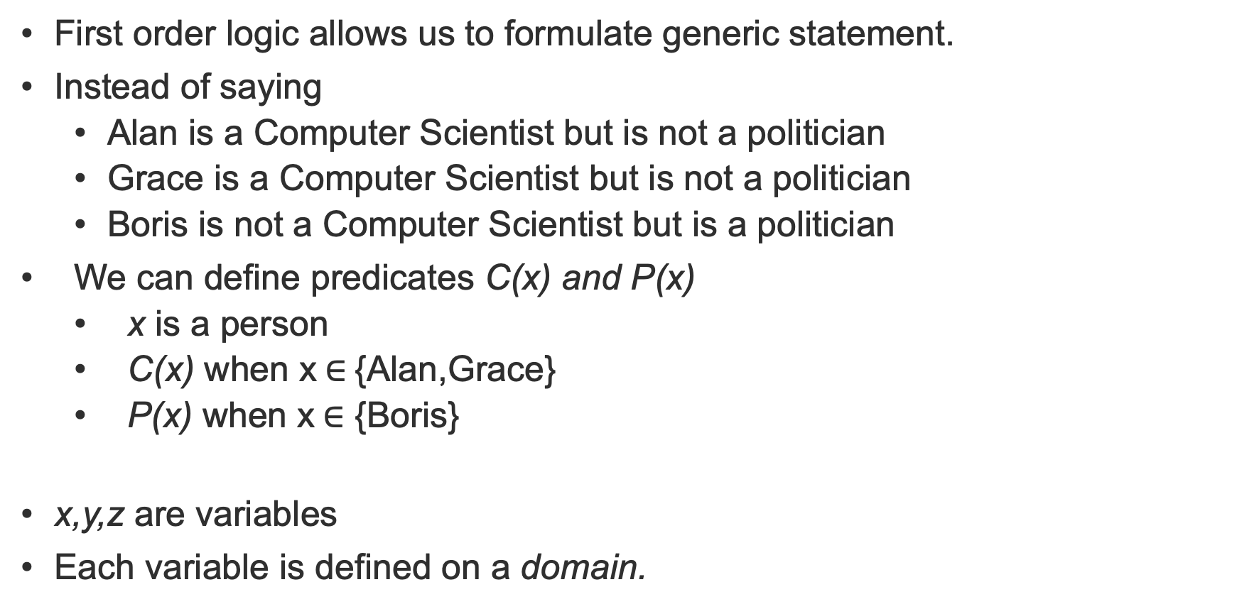
Variables and Predicates
First order logic allows us to formulate generic statement.
Instead of saying
  Alan is a Computer Scientist but is not a politician
  Grace is a Computer Scientist but is not a politician
  Boris is not a Computer Scientist but is a politician
We can define predicates C(x) and P(x)
  x is a person
  C(x) when x$∈${Alan,Grace}
  P(x) when x$∈$ {Boris}
x,y,z are variables
Each variable is defined on a domain.

Slide 31
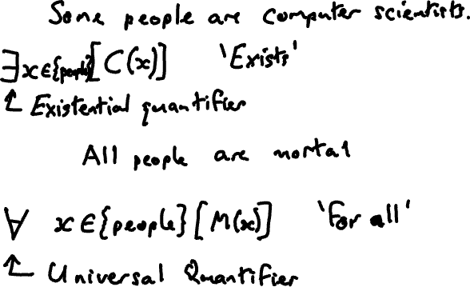
Quantifiers
We may wish to make statements about part or all of a variable domain
Notes:
Exists, forall {Alan, Grace, Boris) C(x), P(x)

Slide 32
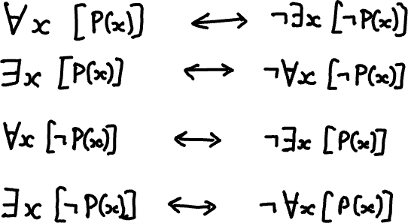
Duality of Quantifiers
Notes:
Consider the following two pairs of statements:
> $\forall\ x\ [C(x)]\quad\iff\quad\lnot\exists\ x\ [\lnot C(x)]$
and
> $\exists\ x\ [C(x)]\quad\iff\quad\lnot\forall\ x\ [\lnot C(x)]$
Are these statements True?
What about the following statements?
> $\forall\ x\ [\lnot C(x)]\quad\iff\quad\lnot\exists\ x\ [C(x)]$
and
> $\exists\ x\ [\lnot C(x)]\quad\iff\quad\lnot\forall\ x\ [C(x)]$
The quantifiers $\forall$ and $\exists$ are said to be **dual** to each other.

Slide 33
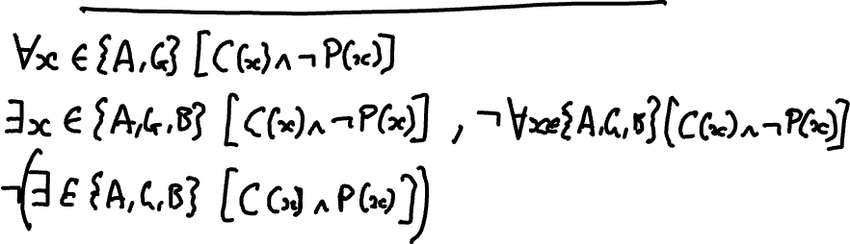
Logical Connectives
We can use connectives with both predicates and quantifiers
Notes:
Alan and Grace C(x) and not P(x)
Boris P(x) and not C(x)
No x in {A,G,B) such that P^C

Slide 34
Building a Knowledge Base with First Order Logic
A familiar example
Students
Professors
Courses
Modules
Assessments

Slide 35
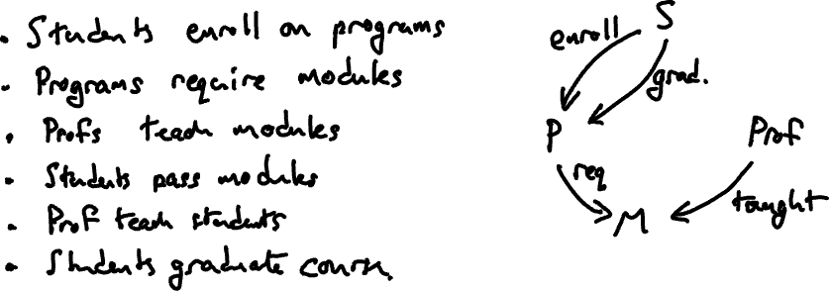
The Scenario
Notes:
DRAW DIAGRAM
Student(x) x is a student
Professor(x) x is a Professor
Course(x) x is a degree Course
Module(x) x is a course module
Enrolled(s,p) Student s is enrolled on Course p
Requires(p,m) Course p requires module m
Teaches(p,m) Professor p teaches module m
Passed(s,m) Student s passed module m
Advises(p,s) Professor p advises student s
Graduates(s,p) Student s graduates from course p

Slide 36
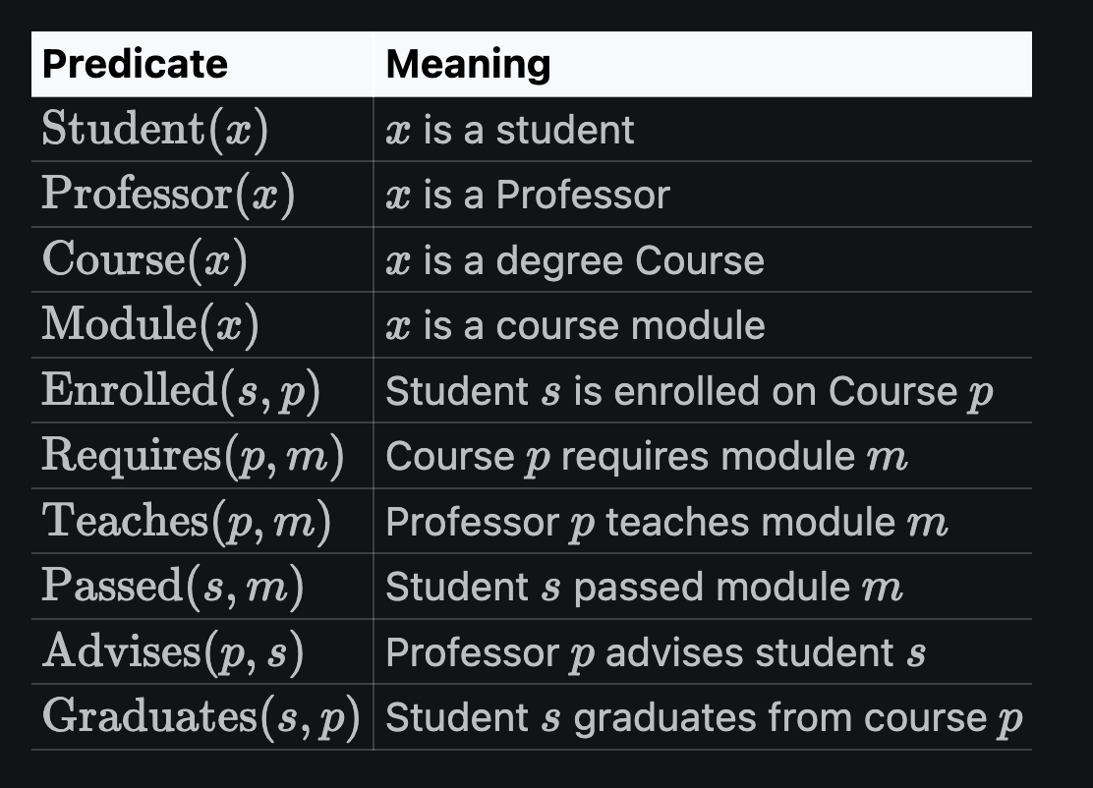
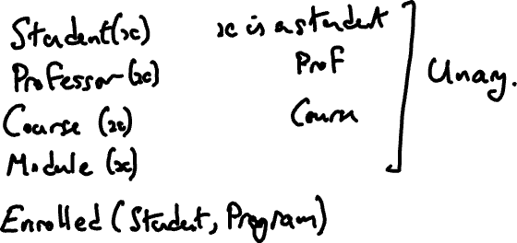
Modelling with Predicates
Notes:
Student(x) x is a student
Professor(x) x is a Professor
Course(x) x is a degree Course
Module(x) x is a course module
Enrolled(s,p) Student s is enrolled on Course p
Requires(p,m) Course p requires module m
Teaches(p,m) Professor p teaches module m
Passed(s,m) Student s passed module m
Advises(p,s) Professor p advises student s
Graduates(s,p) Student s graduates from course p

Slide 37
A Knowledge Base in First Order Logic
Student(Alice)
Student(Bob)
Student(Chen)
Professor(Diana)
Professor(Edward)
Professor(Faye)
Course(AI)
Module(ECS8050)
Module(ECS8051)
Module(ECS8052)
Enrolled(Alice,AI)
Enrolled(Bob,AI)
Enrolled(Chen,AI)
Teaches(Diana,ECS8050)
Teaches(Edward,ECS8051)
Teaches(Faye,ECS8052)
Requires(AI,ECS8050)
Requires(AI,ECS8051)
Requires(AI,ECS8052)
Passed(Alice,ECS8050)
Passed(Alice,ECS8051)
Passed(Alice,ECS8052)
Passed(Bob,ECS8050)
Passed(Bob,ECS8052)
Passed(Chen,ECS8050)
Passed(Chen,ECS8051)
Passed(Chen,ECS8052)
This is a Graph!
Unary Predicates correspond to nodes in the graph
Binary Predicates correspond to directed edges

Slide 39
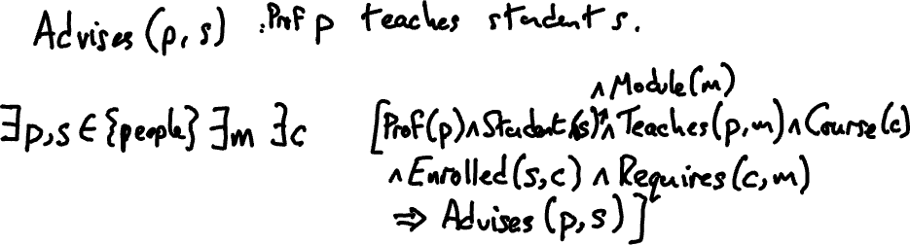
Adding Rules to Derive New Facts
∃m,c[Professor(p)∧Student(s)∧Teaches(p,m)∧Course(c)∧Enrolled(s,c)∧Requires(c,m) ⇒ Advises(p,s)]
Notes:
∃m,c[Professor(p)∧Student(s)∧Teaches(p,m)∧Course(c)∧Enrolled(s,c)∧Requires(c,m) =⇒ Advises(p,s)]

Slide 40
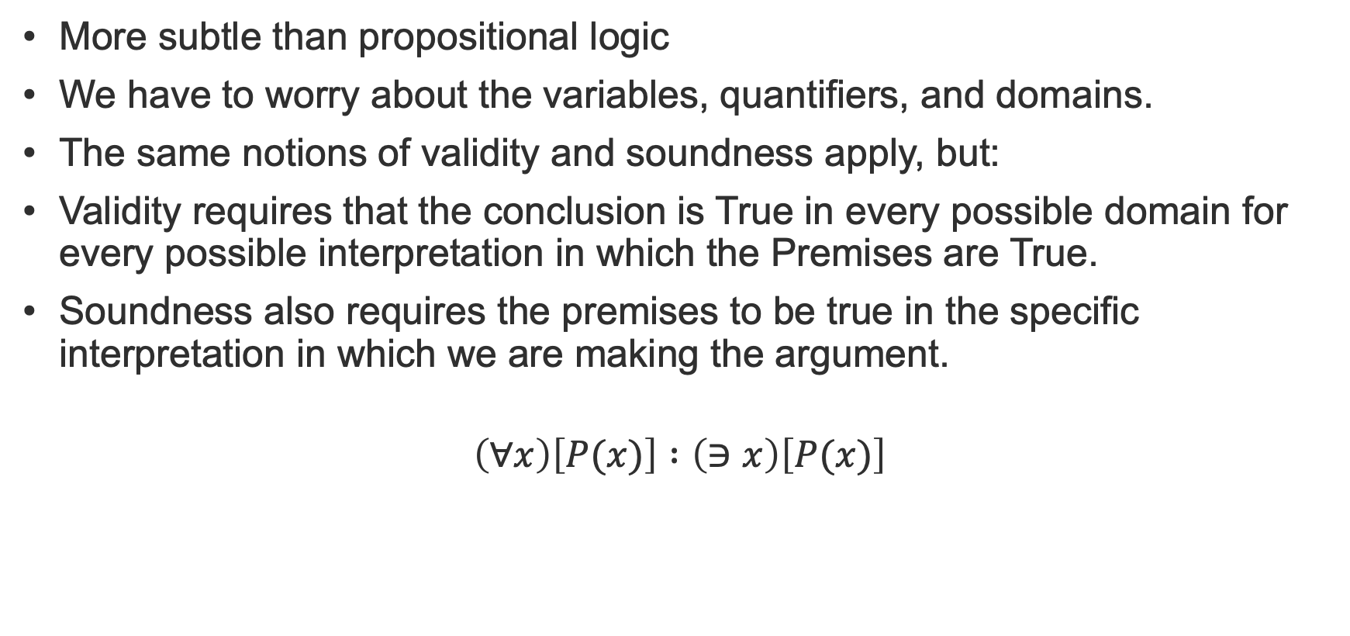
Correctness of Arguments
More subtle than propositional logic
We have to worry about the variables, quantifiers, and domains.
The same notions of validity and soundness apply, but:
Validity requires that the conclusion is True in every possible domain for every possible interpretation in which the Premises are True.
Soundness also requires the premises to be true in the specific interpretation in which we are making the argument.
$$\left(∀x\right)\left[P(x)\right] :\left(∋x\right)\left[P(x)\right]$$
Notes:
Argument shown is valid. It is sound if x is bicycles and P is “has two wheels”. It is not sound if P is has two wheels and x is birds, because the premise forall x P(x) is False.

Slide 41
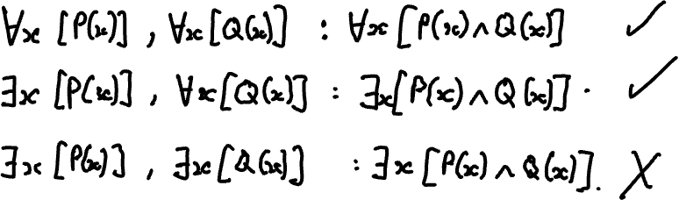
Natural Deduction
Natural Deduction is much more subtle that for propositional logic
All of the same rules apply but need to be applied with care.
Are the following arguments valid or invalid? Where is the error in reasoning?
Notes:
Write in
forall x [P(x)], forall x [Q(x)] : forall x P(x)^Q(x)
exists x [P(x)], forall x [Q(x)] : exists P(x)^Q(x)
exists x [P(x)], exists x [Q(x)] : exists P(x)^Q(x)

Slide 42
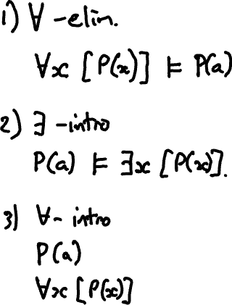
Some new rules
Notes:
### $\forall$-elimination
The basic idea here is that if a formula is universally quantified, then we can infer a particular instance
> 1. $\forall x [\phi(x)]$
> 2. $\phi(a)$
This is related to $\land$-elimination because $\forall x [\phi(x)] \equiv \phi(a) \land\phi(b)\land\phi(c)\dots$
### $\exists$-introduction
Given a particular instance we can infer an existential quantification
> 1. $\phi(a)$
> 2. $\exists x [\phi(x)]$
This is related to $\or$-introduction because $\exists x [\phi(x)] \equiv \phi(a) \lor\phi(b)\lor\phi(c)\dots$
### $\forall$-introduction
> 1. $\phi(a)$
> 2. $\forall x [\phi(x)]$
Why can we do this? If $\phi(a)$ is true for some arbitrary $a$, then, if we know nothing at all about $a$ then it must be True for all $a$. We can only do this if we know nothing else about the particular instance $a$ (ie it is not used in any of the premises of the proof).

Slide 43

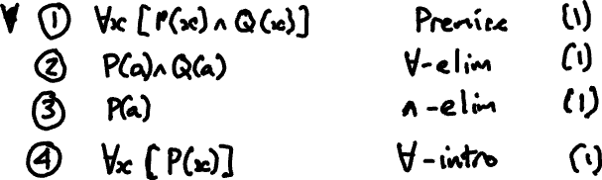
Proofs in First Order Logic
Process is somewhat different
Applying proof rules under a quantifier can be fraught with error
Typically proceed by eliminating the quantifiers, apply the rules, and then reintroduce the quantifiers
Example: $∀x\left[P\left(x\right)∧Q\left(x\right)\right] :∀x\left[P\left(x\right)\right]$
Notes:
Example 1

Slide 44

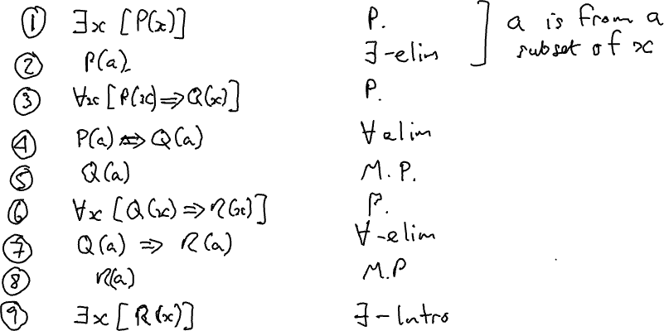
Another Proof
$$∃x\left[P\left(x\right)\right], ∀x\left[P\left(x\right)⇒Q\left(x\right)\right], ∀x\left[Q\left(x\right)⇒R\left(x\right)\right] : ∃x\left[R\left(x\right)\right]$$

Slide 45

Third example
$$\left(∀x\right)\left(∀y\right)\left[P\left(x,x\right)\right] : \left(∃x\right)\left(∃y\right)\left[P\left(x,y\right)\right]$$

Slide 46
1.13 Exercises First Order Logic

Slide 47
Day 2 Wrap-up
Logic programming with Kanren
Forward and Backward Chaining
Proof and Search
First Order Logic
Next Week:
First Order Logic Programming
Knowledge Graphs

